Slide 1

UtsavKart
PROJECT-II Presentation
E-Commerce Web Application
Presented by :
1. Atul Kr Pandey - 19106107003
2. Aditya Kr Ashwini - 19106107006
3. Krishna Murari - 19106107015
Mentor: Dr. Rajeev Ranjan (Assist. Professor)
Department of Information Technology
Muzaffarpur Institute of Technology, Muzaffarpur

Slide 2
Contents
Abstract
Objective
System Requirements
Flow Chart
Project Snapshots
Conclusion
Future Work

Slide 3
Abstract
UtsavKart (An E-Commerce Website) aims to sell products digitally.
UtsavKart is a powerful system which allows user to purchase product, make online payment, give feedback from all over the world.
This system provides efficient procedures to manage workflow in all collaborative environments.
It helps produce the connections between user, admin and businesses in a most effective way.
UtsavKart is build using cutting-edge technologies such as React.js, Node.js, Express.js, and MongoDB, enabling businesses to offer a seamless online shopping experience to their customers.

Slide 4
Objective
Develop a user-friendly interface.
Implement a comprehensive search and filtering system
Enhance User Experience
Optimize mobile responsiveness
Enable real time product tracking system
Password management system with email validation
Admin dashboard for products, user, finance and review details

Slide 5
System Requirements
Technology Used :
React.js
Node.js
Express.js
MongoDB
Hardware Requirements :
40 GB hard disk
256 MB RAM
Software Requirements :
VS Code
Postman
Strip

Slide 6
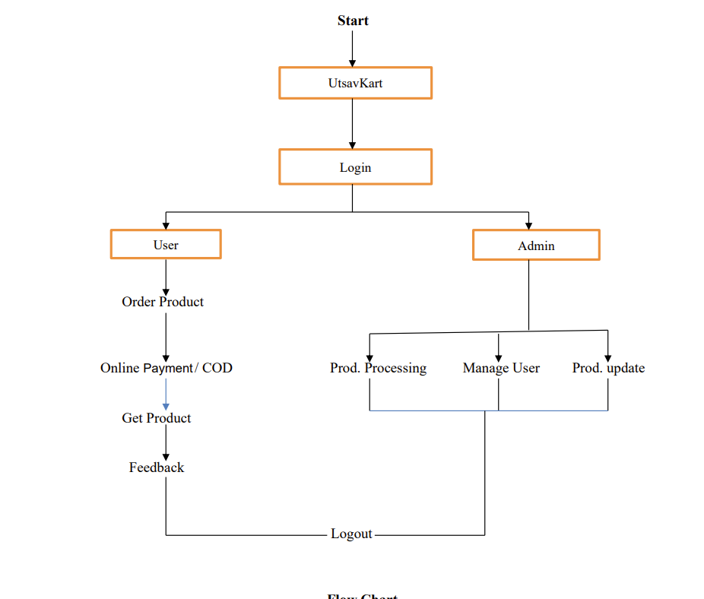
Flow Chart

Slide 7
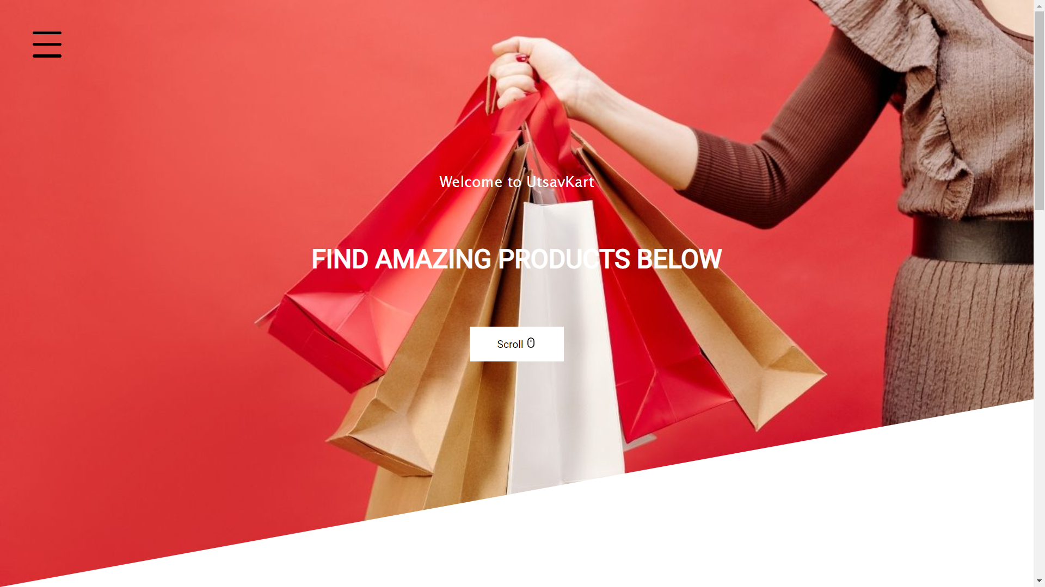
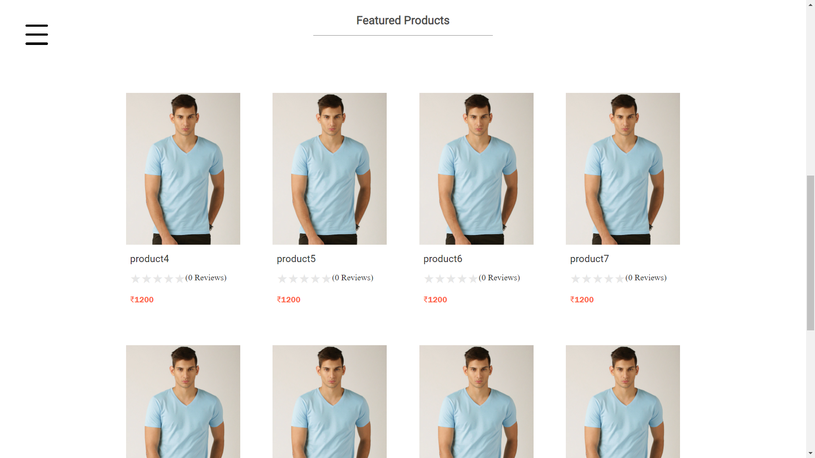
Project Snapshots

Slide 8
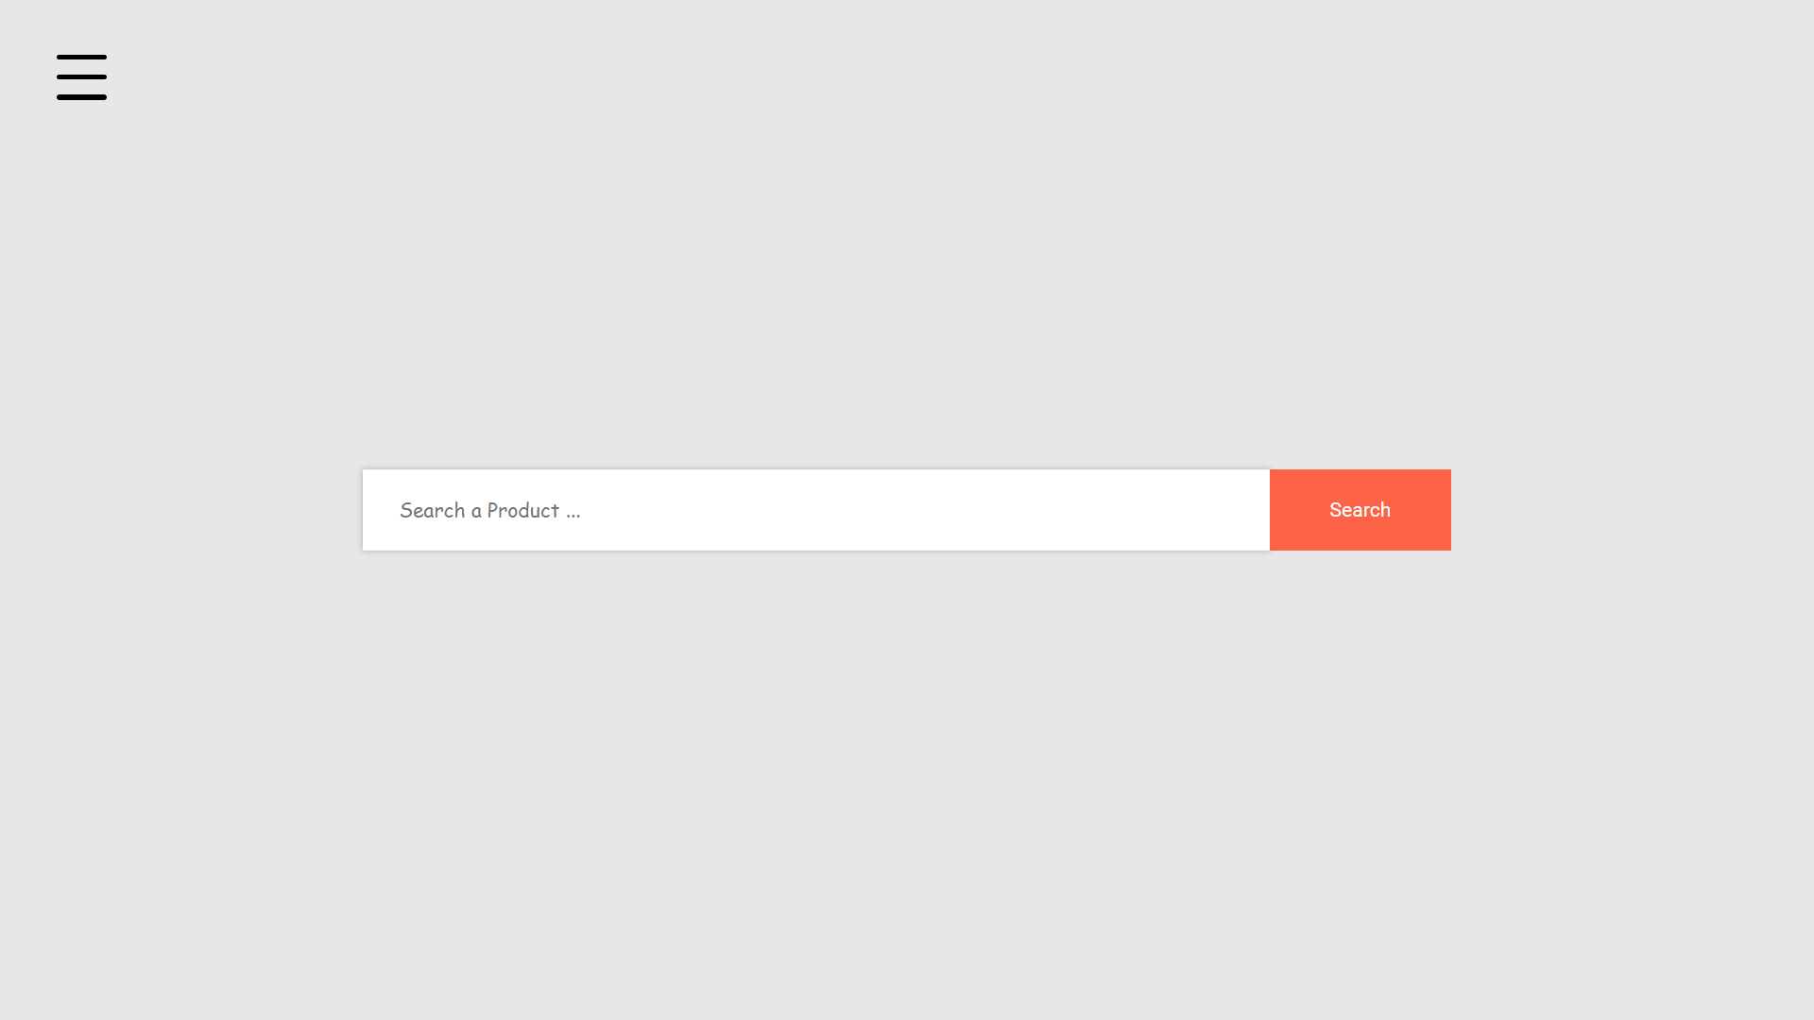
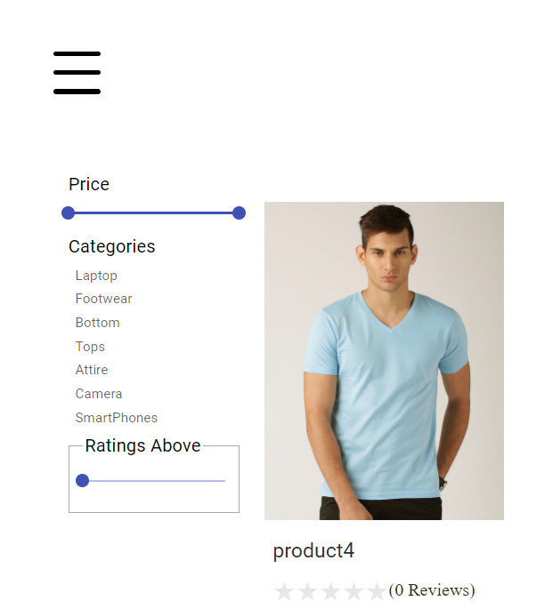
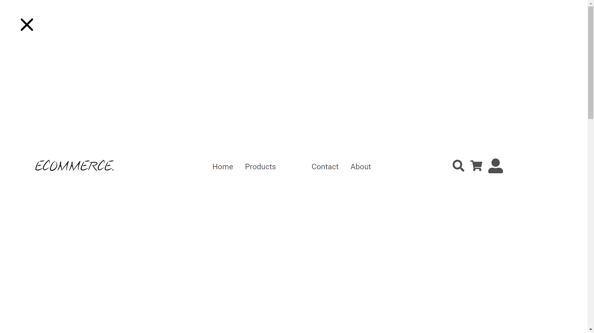
Project Snapshots Cont….

Slide 9
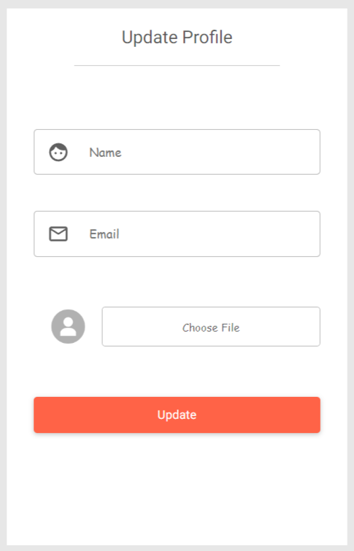
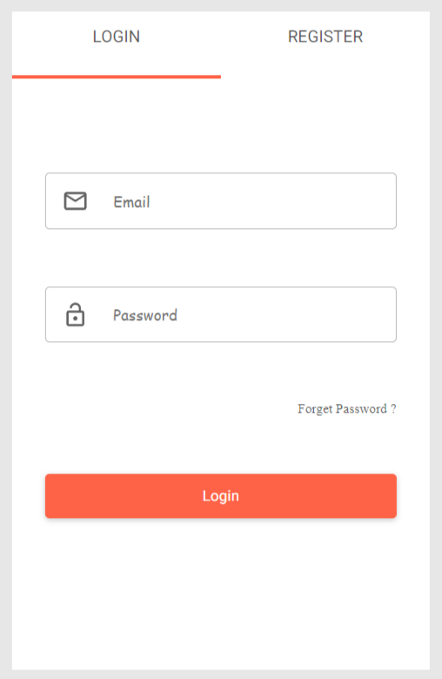
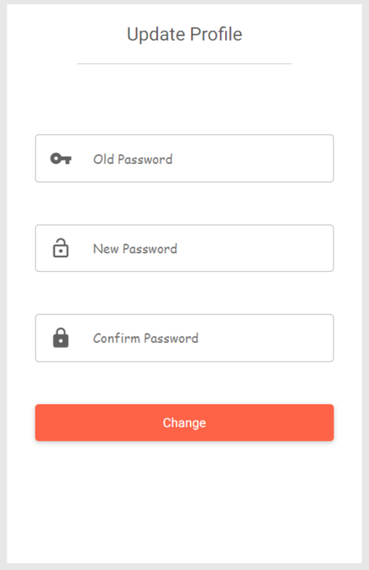
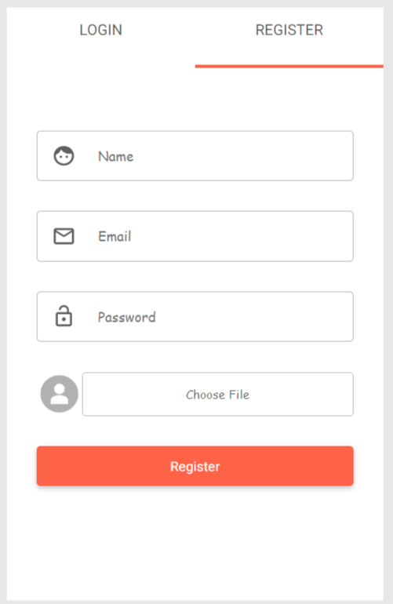
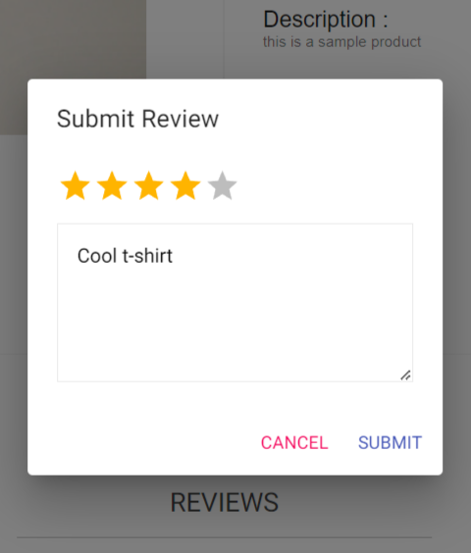
Project Snapshots Cont….

Slide 10
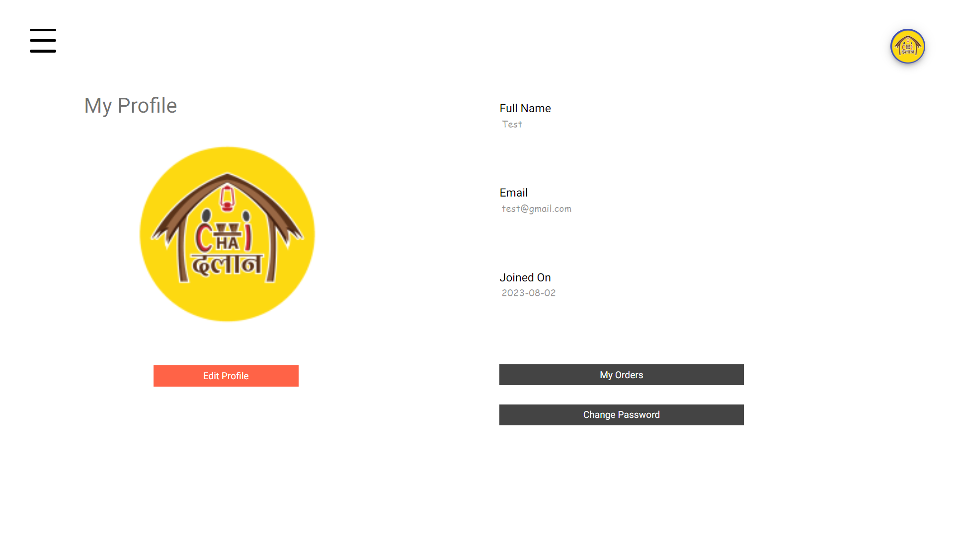
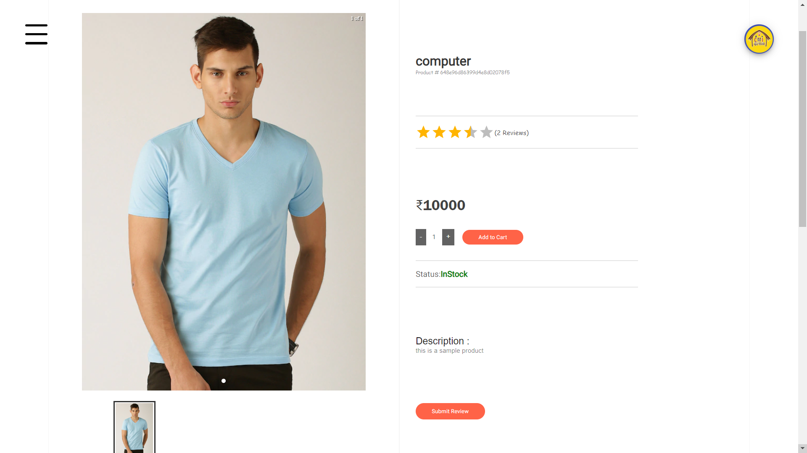
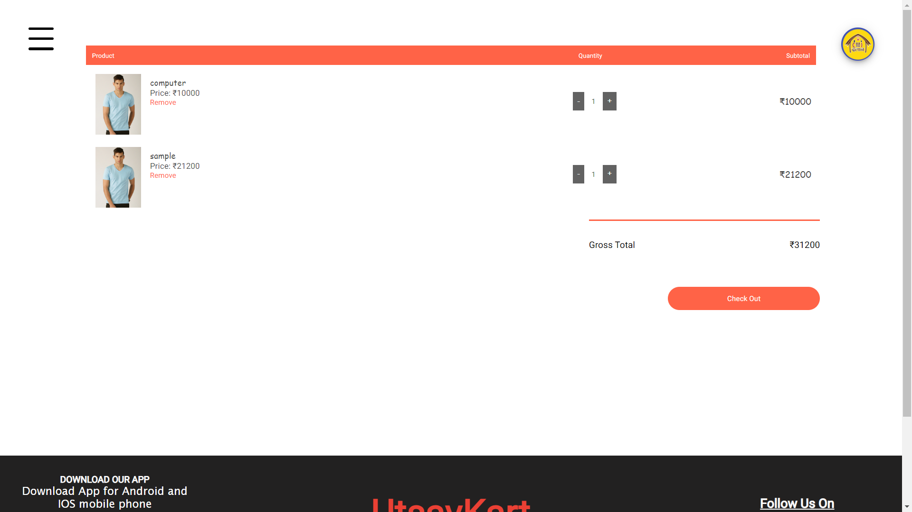
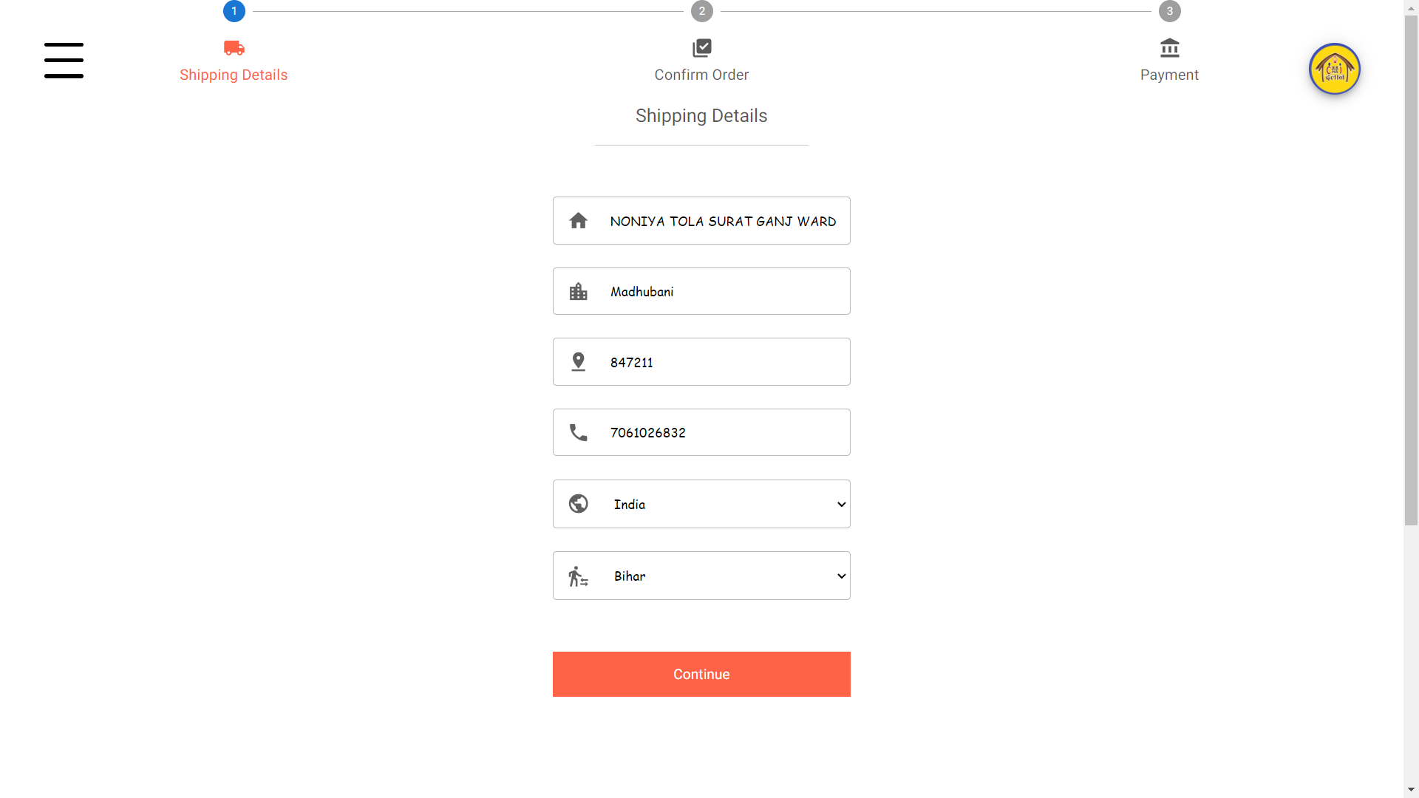
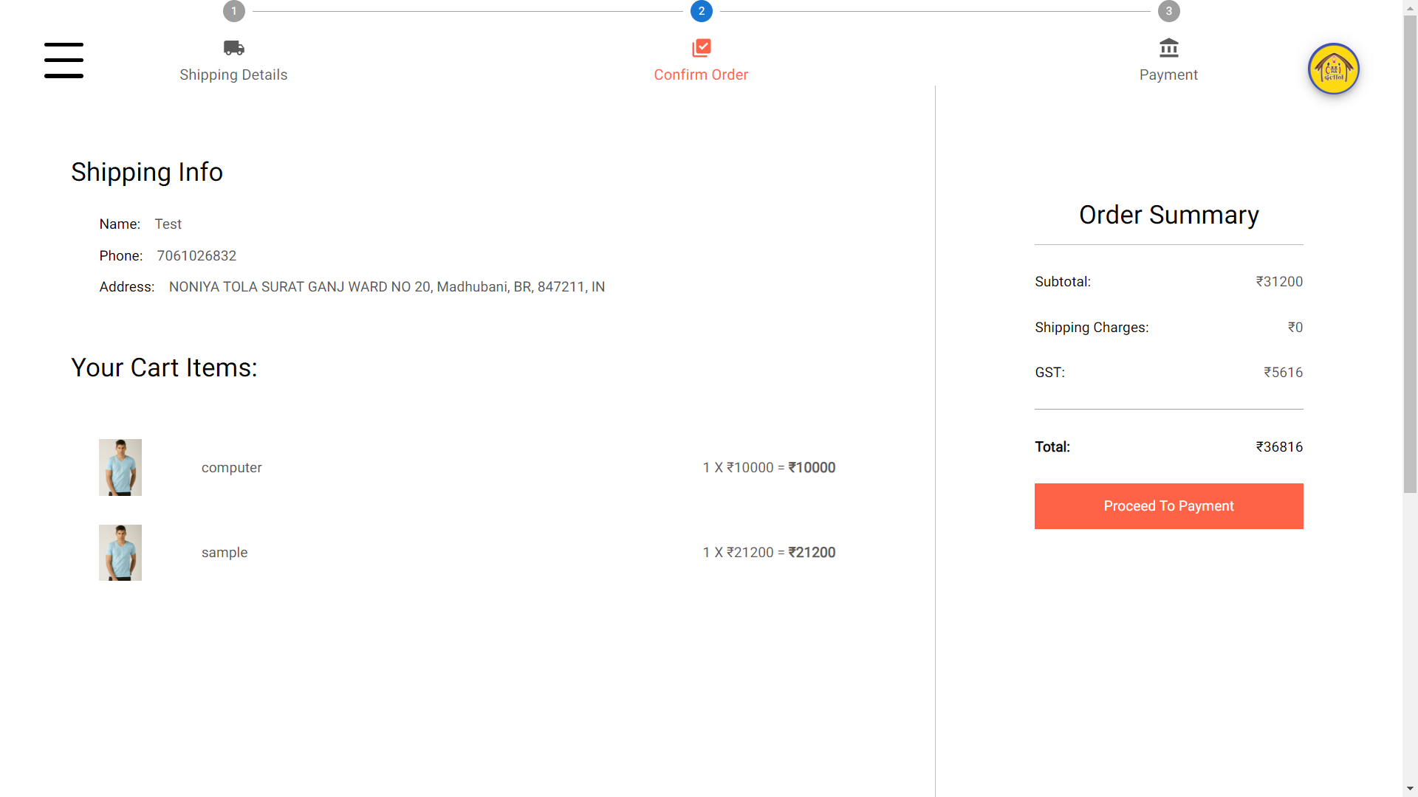
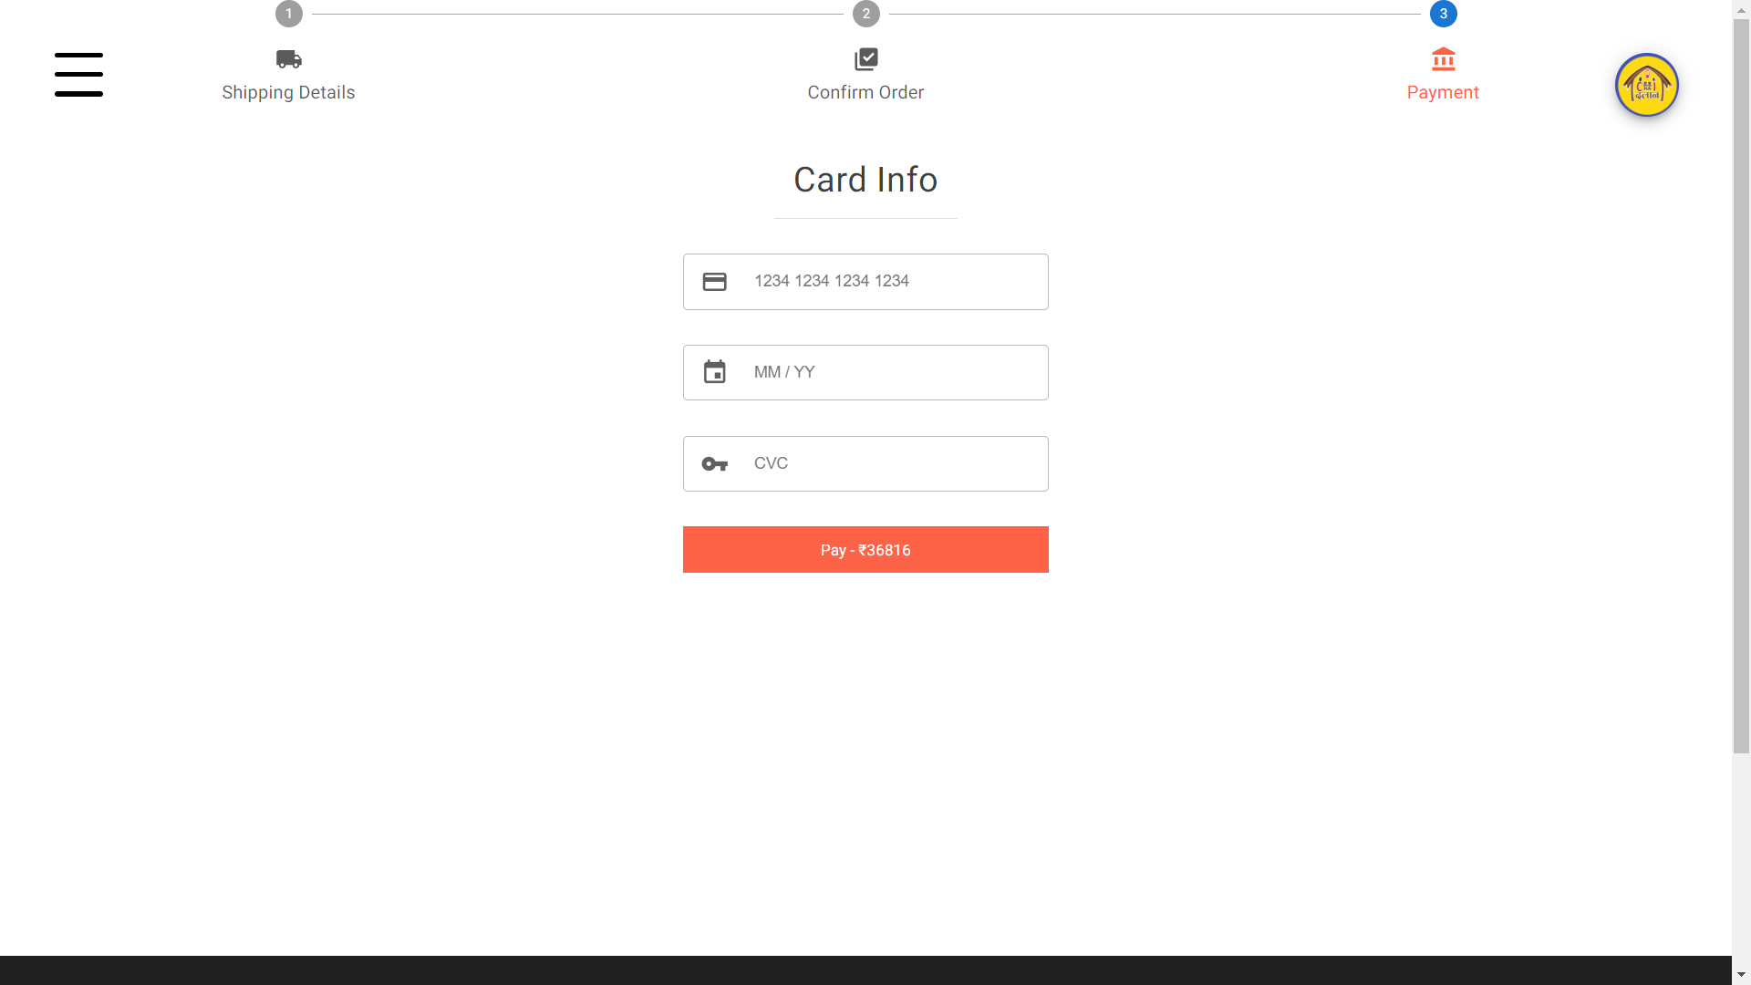
Project Snapshots Cont….

Slide 11
Conclusion
E-commerce has revolutionized the way business is conducted.
Offering convenience to consumers and new opportunities for businesses.
However, challenges and evolving trends emphasize the need for continuous adaptation and innovation in the e-commerce landscape.

Slide 12
Future Work
This project fulfills partial requirements of the UTSAVKART. The future works of the project will include :
User Experience Enhancement
Integration with Social Commerce
Loyalty and Reward Programs

Slide 13
References
Reference website, accessed 1st June 2023 < https://www.starbinod.com/ >
React, accessed 5th June 2023 < https://react.dev/reference/react >
Node, accessed 5th July 2023 < https://nodejs.org/en/docs >
Express, accessed 15th June 2023 < https://expressjs.com/en/guide/routing.html >
MongoDB, accessed 15th July 2023 < https://www.mongodb.com/docs/develop-applications/ >

Slide 14
THANK YOU

